Slide 1


Fakeology A Fake Review Detection Web Application
Presenter: Zach Shim
Faculty Advisor: Min Chen
CSS 497 Capstone Colloquium Presentation

Slide 2


Background
Product reviews on online shopping sites have become a vital asset for consumers.
Sellers will manipulate reviews on their products and services to sway customer opinions.
Therefore, it can often be difficult to differentiate real reviews from fake ones.

Slide 3
Legacy Project
A collection of python scripts that featured several data mining algorithms.
Used a static Amazon dataset that contained product information and customer reviews.
Three step classification system:
1. Detection of duplicate reviews.
2. Detection of incentivized reviews.
3. Detection of anomalous ratings and reviews.

Slide 4
Project Requirements
Create a full-stack application using Django
Front-End (HTML, CSS, JS)
Screen 1: Search for data of past-analzyed products.
Screen 2: Allow user to paste a link to an amazon review for analysis.
Screen 3: Show statistical data about possible ‘fake’ reviews.
Back-End (Python, SQLite)
Flat file system (csv/json files) -> SQLite database.
Implement a web crawler that scrapes data from the product page.
Add new methodology for detecting fake reviews using a machine learning model.
Improve documentation and readability.

Slide 5
Architecture

Slide 6
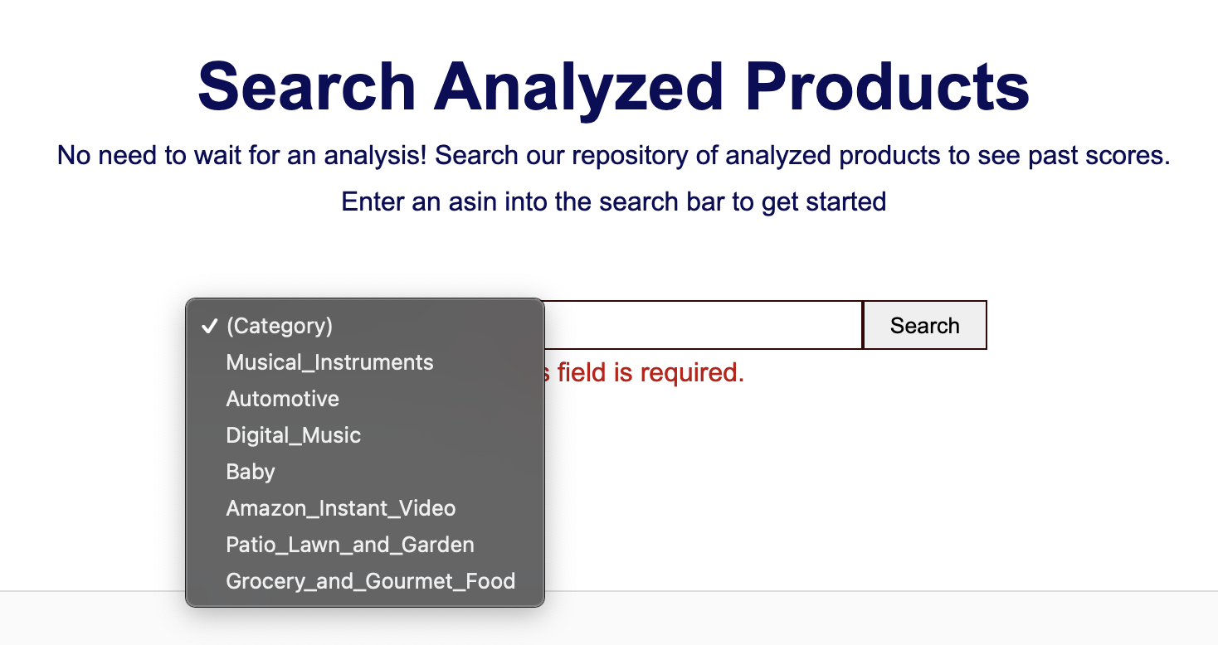
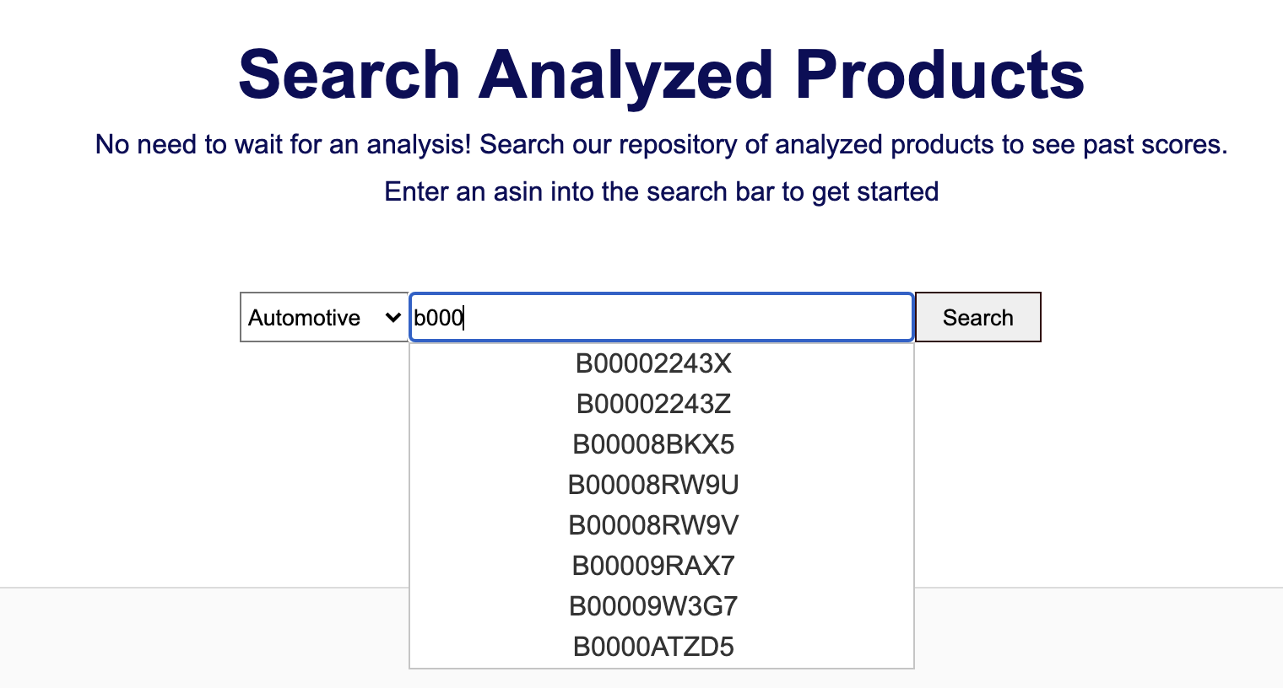
Screen 1 – Chained search bar

Slide 7
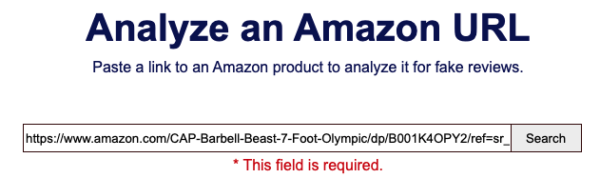
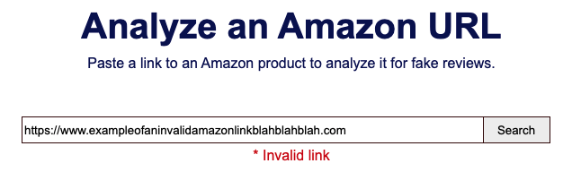
Screen 2 – Insert Link

Slide 8
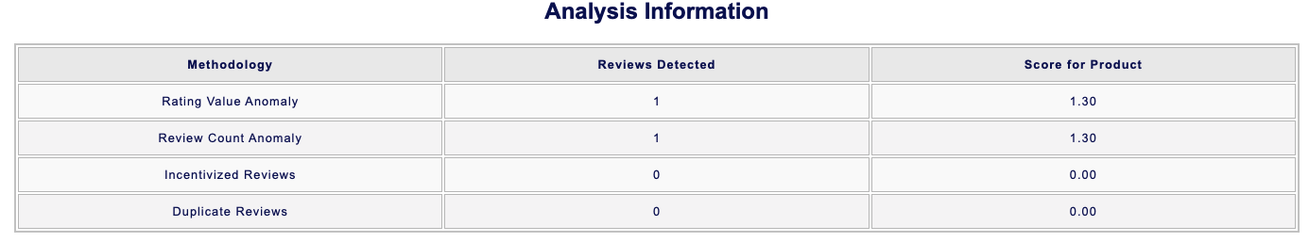
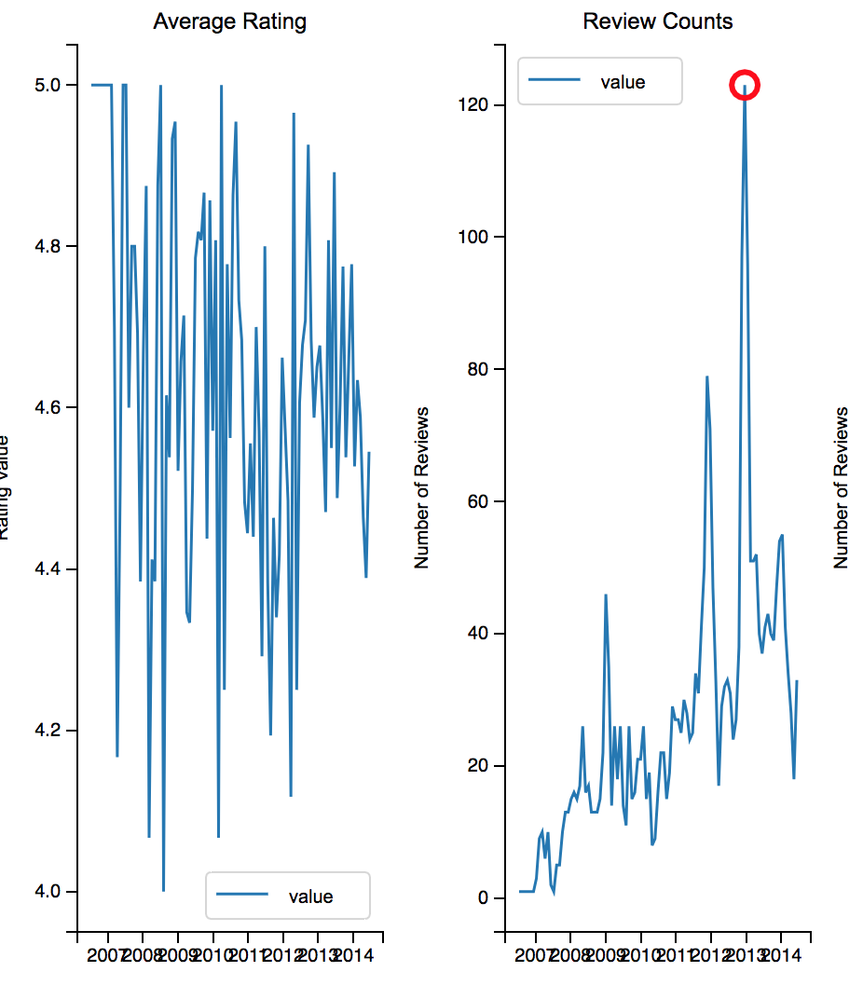
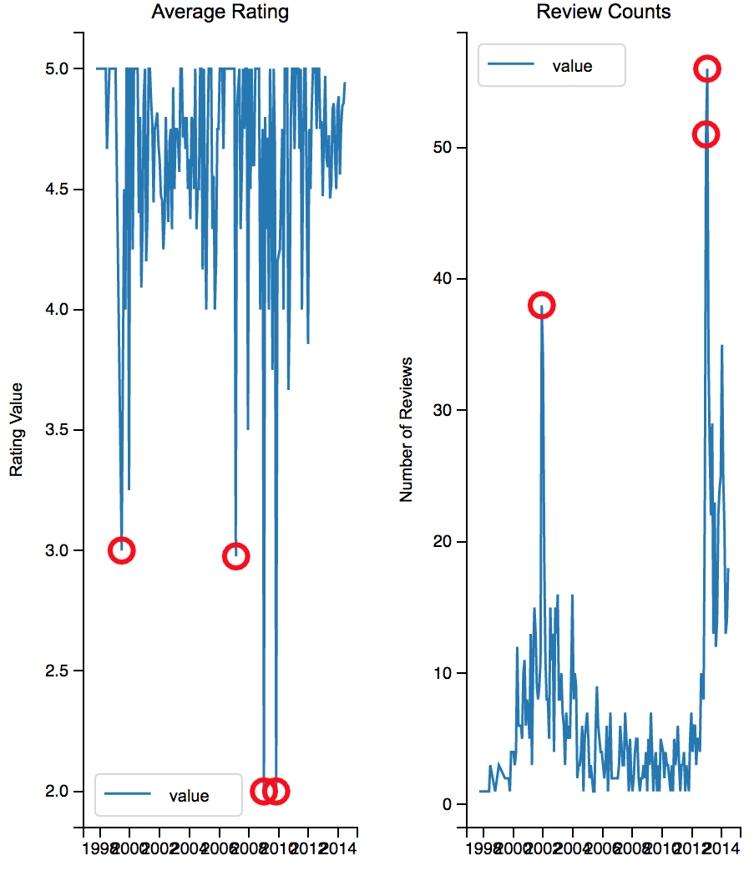
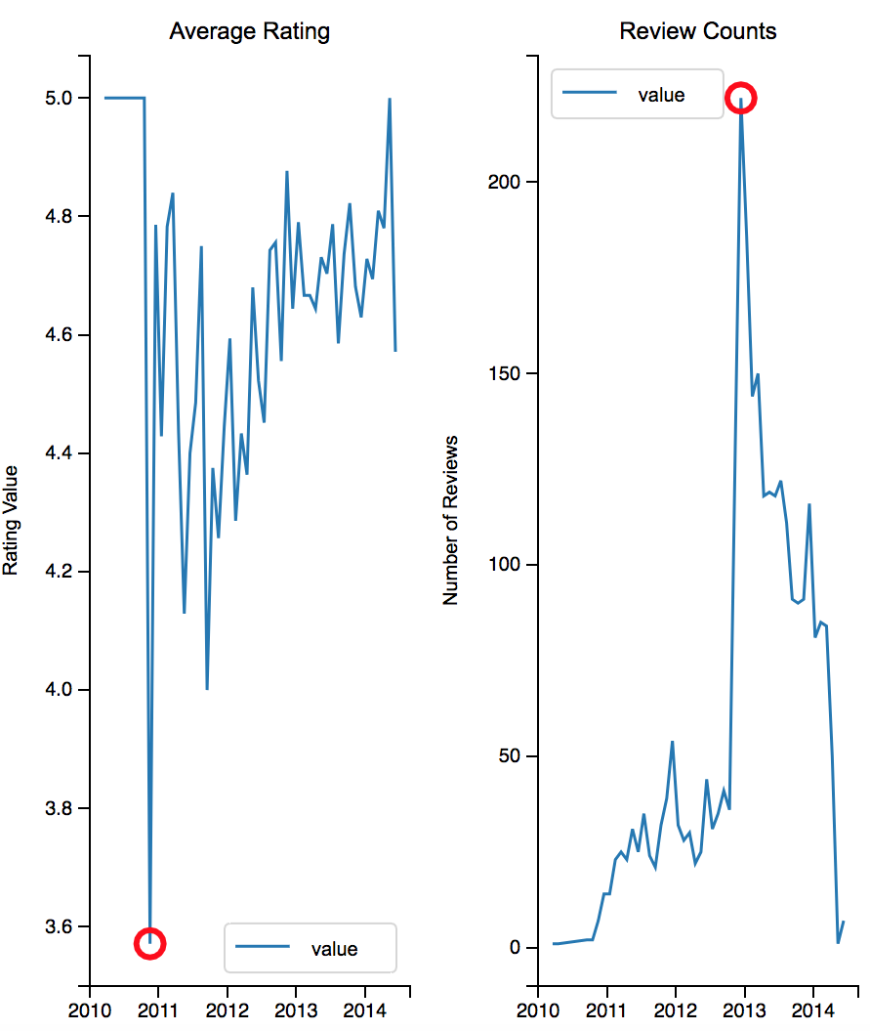
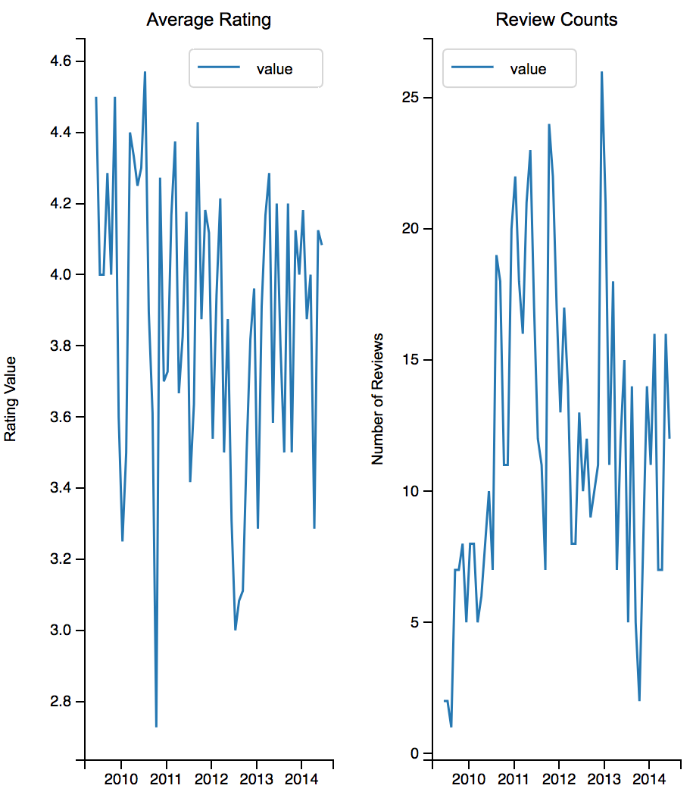
Screen 3 – Results

Slide 9
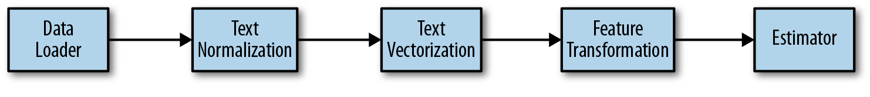
Modeling
Scraping
Tokenization
Lemmatization
Dictionary
Bag-of-words
TFIDF
LSI
Similarity
Sentiment

Slide 10
Modeling
Original Text
“I have purchased this product several times. It is really high
quality and will still be good after many uses.”
Tokenization, Lemmatization, Remove Punctuation
[I', 'have', 'purchase', 'this', 'product', 'several', 'time', ‘it', 'be’, 'really’,
'high', 'quality', 'and', 'will', 'still', 'be’, 'good', 'after’, 'many', 'use']
Dictionary
{'after': 0, 'and': 1, 'be': 2, 'good': 3, 'have': 4, 'high': 5, ‘I': 6, 'is': 7, 'it': 8, 'many': 9, 'product': 10,
'purchased': 11, 'quality': 12, 'really': 13, 'several': 14, 'still': 15, 'this': 16, 'time': 17, 'us': 18, 'will': 19}

Slide 11
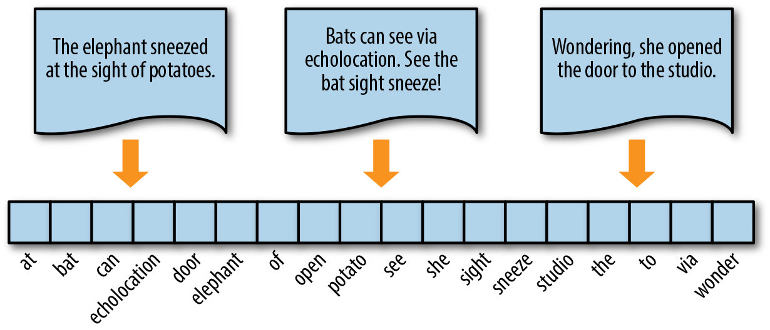
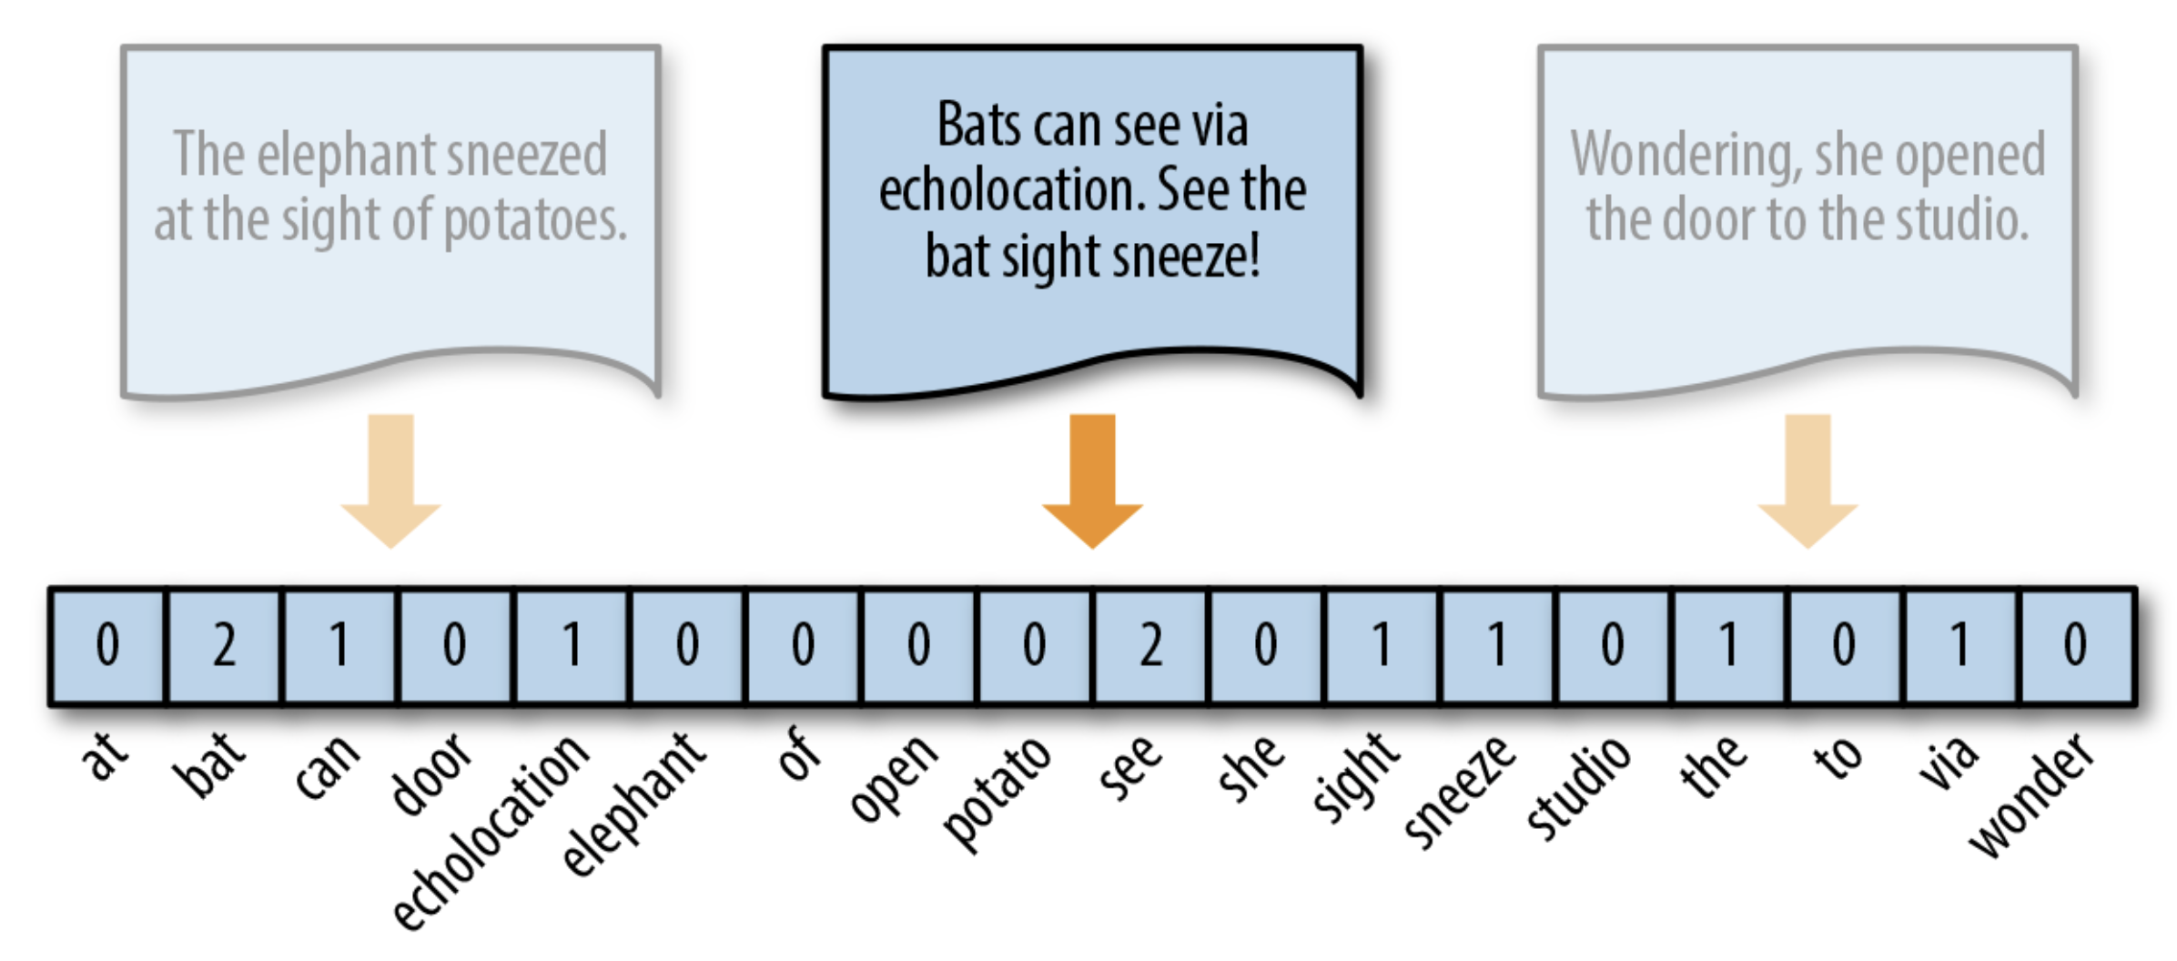
Modeling
Question: How many times does the word ‘bat’ appear in this document?
Bag-Of-Words: Before
Bag-Of-Words: After

Slide 12
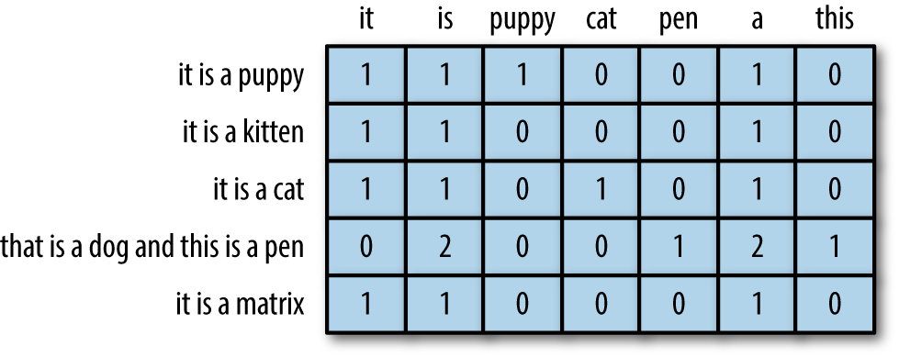
Modeling
Bag-Of-Words to TFIDF

Slide 13
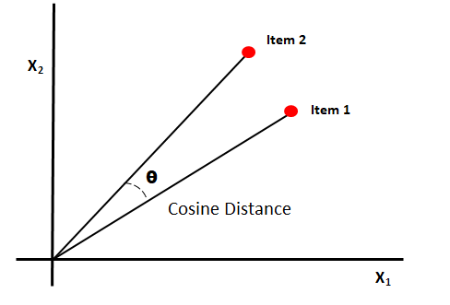

Modeling
1. Unsupervised Similarity Analysis
2. Supervised Sentiment Analysis

Slide 14
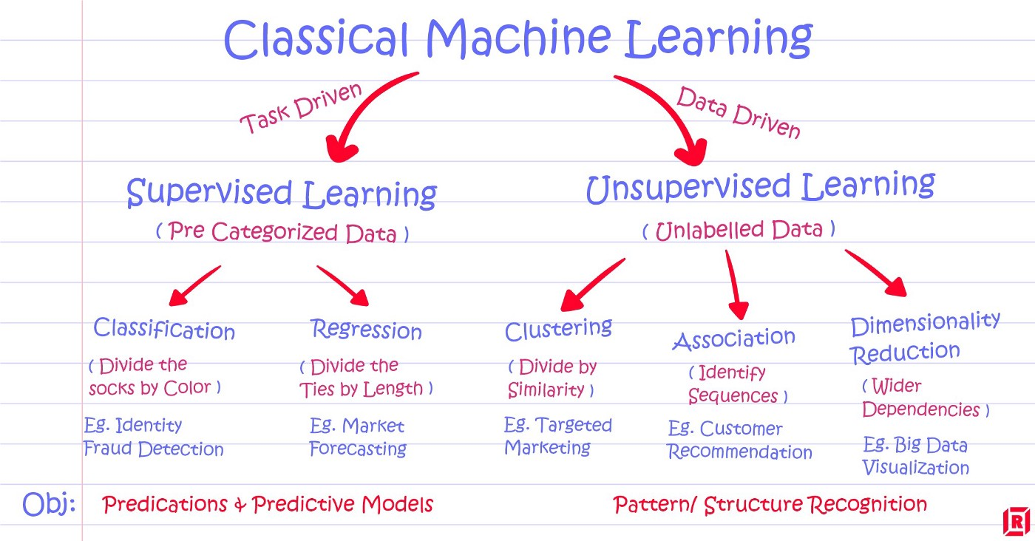
Challenges
Finding the right machine learning model to use.
Amazon has robust bot detection that makes it difficult to scrape data.
Learning several new languages, frameworks, and libraries in a short amount of time.

Slide 15
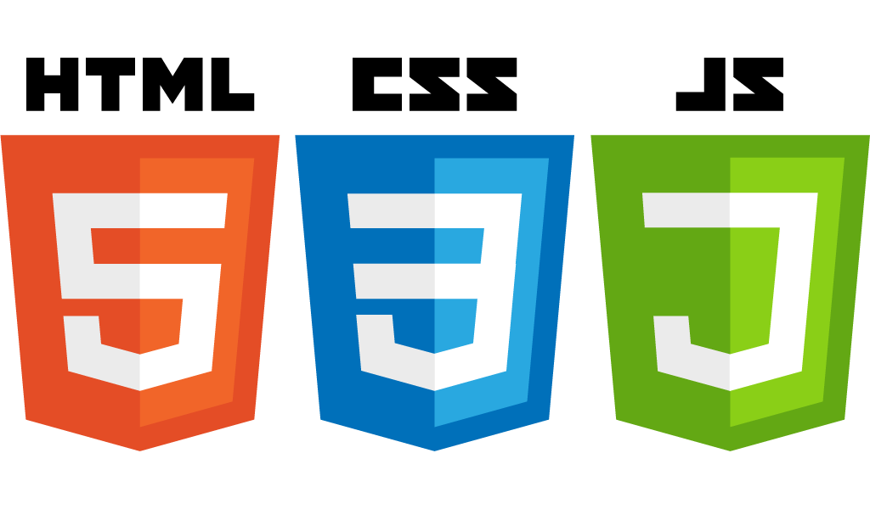






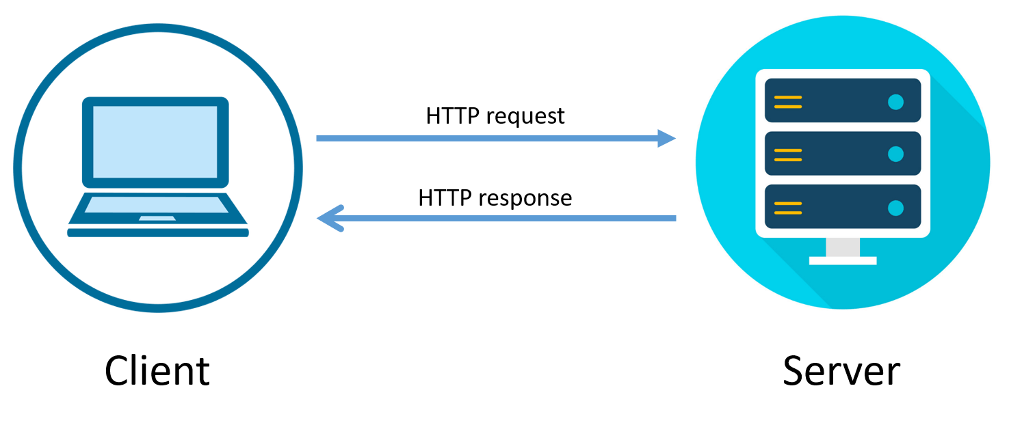
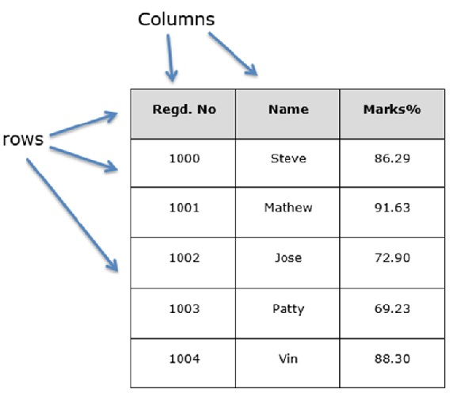
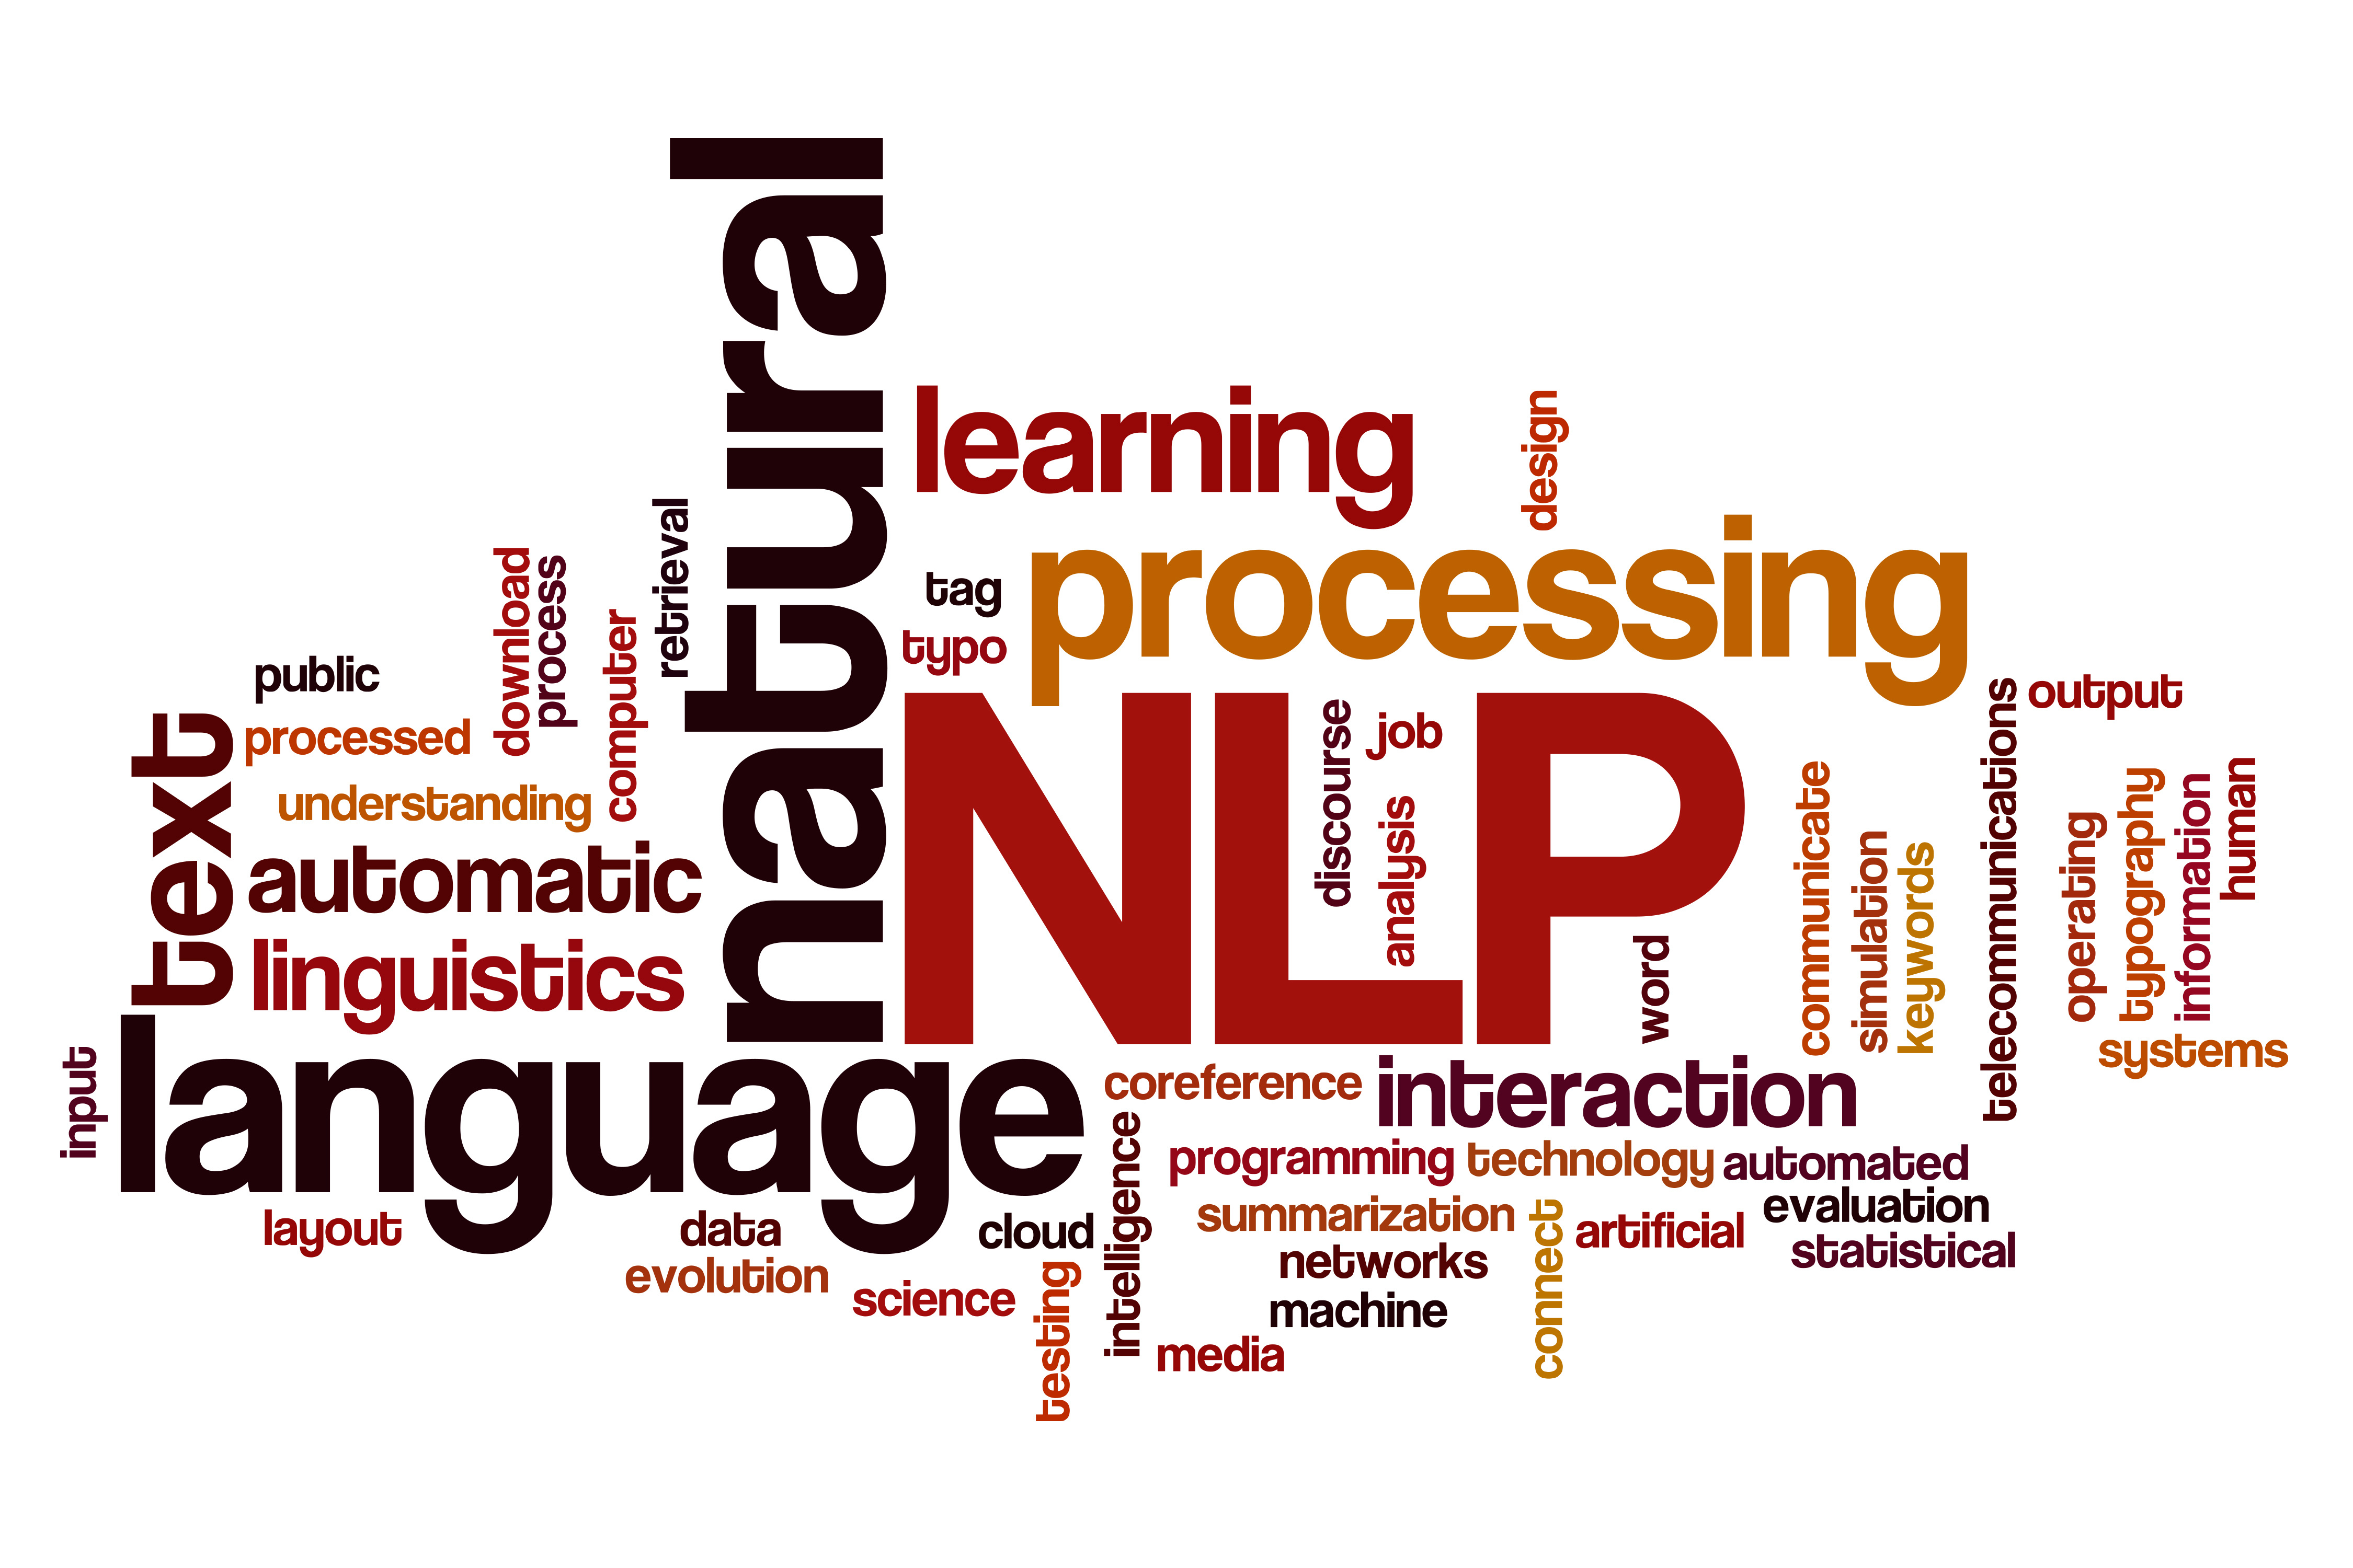
What I Have Learned
Full-Stack Development
Front-End (HTML, CSS, JavaScript)
Back-End (Python, Django, SQLite)
Web scraping
Rotating proxies & User Agents
BeauitfulSoup, Scrapy, lxml, Selenium
Life-cycle of client-server activity
Requests vs. Responses
Forms
Text Classification
Natural Language Processing (NLTK)
Machine Learning Theory & Methodologies
Data Frames and Vectorization

Slide 16
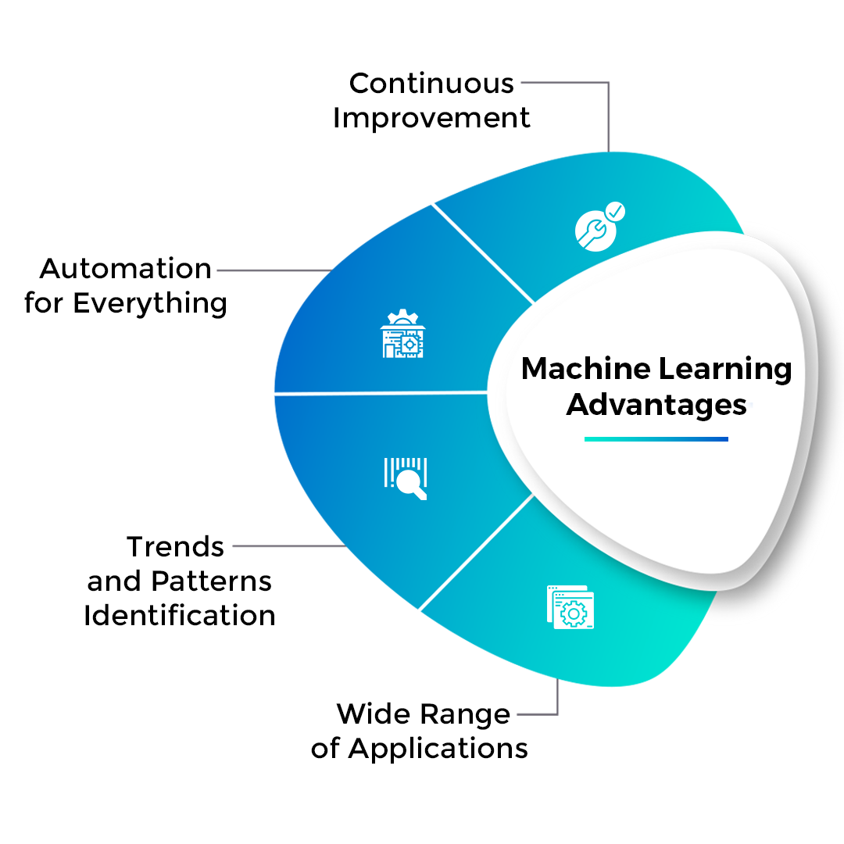
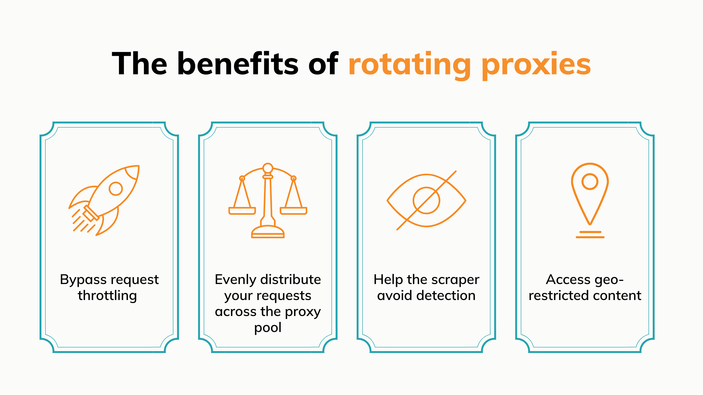
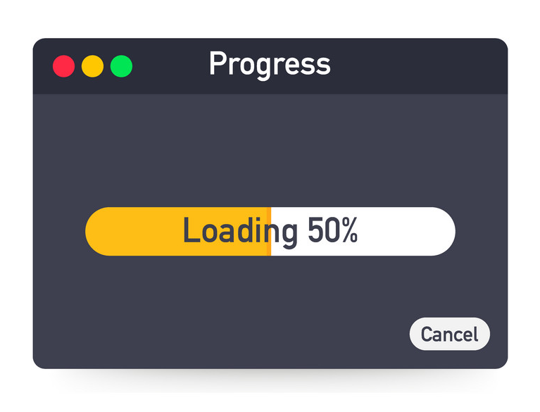
Future Work
Improve methodology with new/different machine learning models.
Improve web scraper. (Paid proxy service, captcha solver, etc.)
Loading bar for long data processing.

Slide 17
Related Coursework
CSS 342 & 343
Data structures & algorithms
Inheritance, Polymorphism, Class Patterns
CSS 360 & 370
UML Diagramming
Agile software development
CSS 475
SQLite
Relational Database Schema
CSS 480 – HCI & UX design
Rapid Prototyping
Affordances
Design Principles

Slide 18
Question & Answer

Slide 19
Question & Answer

Slide 20
Thank you for listening!

